Slide 1
An Ideal Husband
Facts, themes and symbols

Slide 2
KEY FACTS
1. Author: Oscar Wilde
2. Type of work: ……………………..
3. Genre: romantic melodrama
satire of …………………..
„well-made-play“ emphasising bourgeois ………………………………
4. Time and place written: …………………………………………………….
5. Narrator: …………………………………………………………………………….
6. Climax? : …………………………………………….. Plot summary? ………………………………………………..
7. Settings: London, 1895
Protagonists: ………………………………………………………………….

Slide 3
THEMES
A. the ideal marriage / the institution of marriage;
B. the ideal woman; the ideal man; the dandy
The triumph of love
C. a estheticism
D. the art of modern living
E. political corruption
F. forgivness

Slide 4
Symbols
A. The Rococo tapestry
- a representation of François Boucher's "Triumph of Love" (1754). The "Triumph" allegorizes the victory of love over power: Venus points to Vulcan's conquered heart, and the god gazes up at her like a love-sick boy.
- the most obvious: the defeat of Mrs. Cheveley and reconciliation of the play's lovers,
- the significance of the allegory: in the story the tapestry tells, Venus conquers Vulcan only to commit adultery with his brother, Ares. In this sense, Love's triumph is more Mrs. Cheveley's than the Chilterns', the former having similarly betrayed Lord Goring in their youth

Slide 5
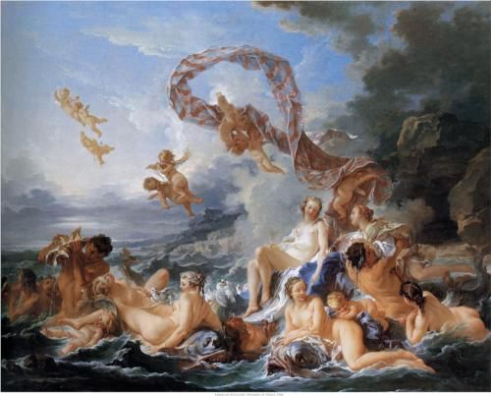

Slide 6
B. The diamond brooch
- a diamond snake, it symbolizes the evil woman—a woman who resembles a skin-shedding reptile in her duplicity
- as an agent of vengeance
- evidence of a past crime, entrapping a woman
- the "duplicity" of the brooch: a wonderful, fabulous ornament which metamorphoses into a trap / dandy - elegant way of opening it, if you know its secret /

Slide 7
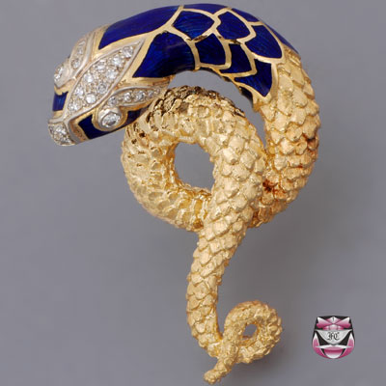

Slide 8
DEFINE
1. An IDEAL husband
2. An IDEAL wife
3. A DANDY
4. An aristocrat
5. A villain/villainess
6. The new Victorian woman
7. An IDEAL marriage
Notes:
An ideal wife: fine figure of womanliness, flurtatious with secrets but honest
The ideal marriage: loyalty, sacrifice, undying love, forgivness, devotion
A dandy: impeccably dressed, gorgeous, inimitablely witty, a philosopher and aristocrat, dangerously clever and well behaved, stunnig with double meaning words
A villain/ness: vicious and opportunistic man/woman
The Victorian new Woman: upright, virtuous, educated, politically engaged, charming , supporting her husband

