Slide 1
NATURAL DISASTERS
A natural disaster is a major adverse event resulting from natural processes of the Earth; examples include floods, volcanic eruptions, earthquakes, tsunamis, and other geologic processes.
A natural disaster can cause loss of life or property damage, and typically leaves some economic damage in its wake, the severity of which depends on the affected population's resilience, or ability to recover.

Slide 2
In 2012, there were 905 natural catastrophes worldwide,
93% of which were weather-related disasters.
45% were meteorological (storms),
36% were hydrological (floods),
12% were climatological (heat waves, cold waves, droughts, wildfires)
and 7 % were geophysical events (earthquakes and volcanic eruptions).

Slide 3
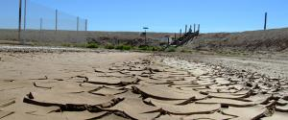
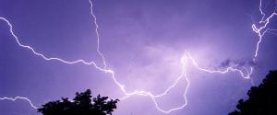
DROUGHT
- a period of reduced rainfall
a
b

Slide 4
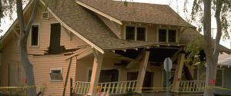
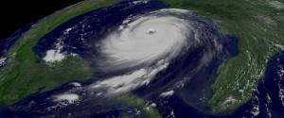
EARTHQUAKE
- the sudden, rapid shaking of the earth
a
b

Slide 5
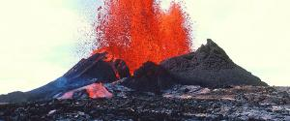
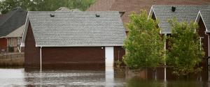
FLOODS
occur when waterways such as rivers or streams
overflow their banks as a result of rainwater
a
b

Slide 6
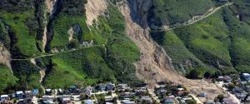
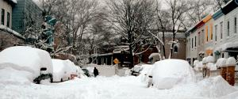
LANDSLIDES
- can be caused by a variety of factors including earthquakes, storms, volcanic eruptions, fire and by human modification of land
- masses of rock, earth or debris move down a slope
a
b

Slide 7
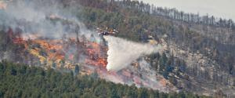
HURRICANES
- a type of tropical cyclone or severe tropical storm
a
b

Slide 8
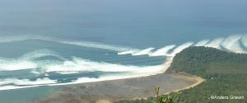
VOLCANO
- a volcano is a mountain that opens downward to a reservoir of molten rock below the surface of the earth - when pressure from gases within the molten rock becomes too great, an eruption occurs
a
b

Slide 9
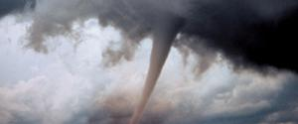
TORNADO
- is nature’s most violent storm
- appears as a rotating, funnel-shaped cloud that extends from a thunderstorm to the ground with whirling winds that can reach 300 miles per hour
a
b

Slide 10
WILDFIRE
- is usually triggered by lightning or accidents
a
b

Slide 11
Bali volcano, 2017
http://www.bbc.com/news/av/world-asia-42157914/bali-volcano-inside-the-mount-agung-exclusion-zone
http://www.bbc.com/news/av/world-asia-42133505/bali-volcano-warning-over-dangerous-mud-flows
Slovenia floods, 2007
https://www.youtube.com/watch?v=wrobrnF-PWo
Iran, Iraq quake, 2017
http://www.bbc.com/news/av/world-middle-east-41973049/moment-iran-iraq-quake-hits-darbandikhan-dam-control-room

Slide 12
Washinton,Illinois - tornado rips apart homes, lives
http://edition.cnn.com/video/data/2.0/video/weather/2013/11/18/natpkg-midwest-tornado.cnn.html
Typhoon Haiyan: Before and after the storm
Coastal towns across the central Philippines have been left devastated by Typhoon Haiyan, which brought gusts of wind of up to 275 km/h (170 mph) and waves as high as 15m (45ft).
http://www.bbc.co.uk/news/world-24899001

