Slide 1
Themes, motifs and sybolism in animal farm

Slide 2


Animal Farm as an allegory
The most well-known and widely-accepted interpretation
The Russian Revolution,
Rise of Stalin and Communism,
Orwell: Not against socialist ideas, but against the Soviet Union
Exile of Snowball,
Purges, mock tirals
Eventuall abandonment of core ideas

Slide 3
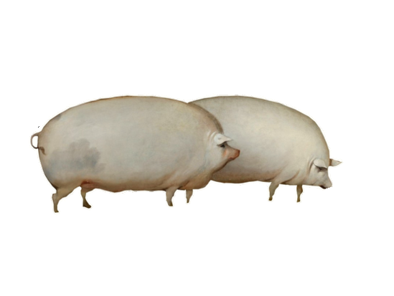
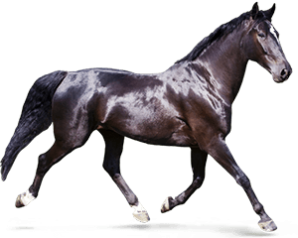
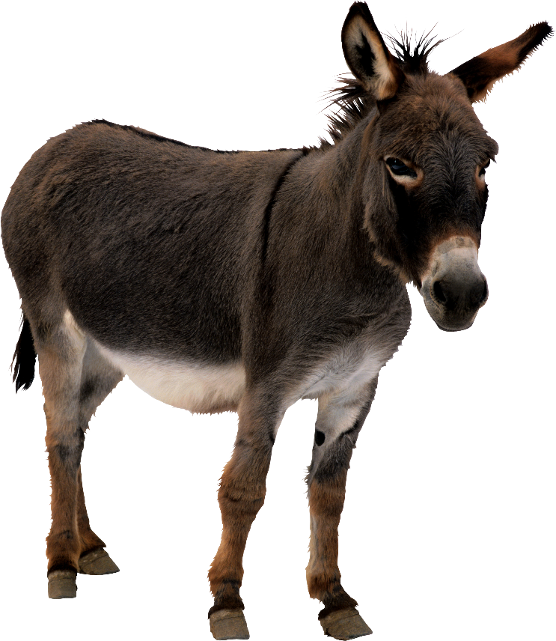
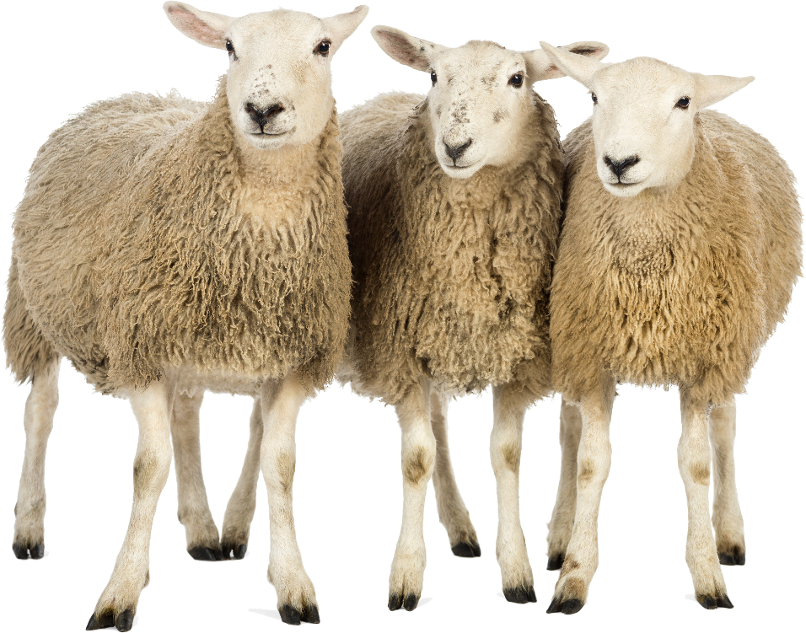
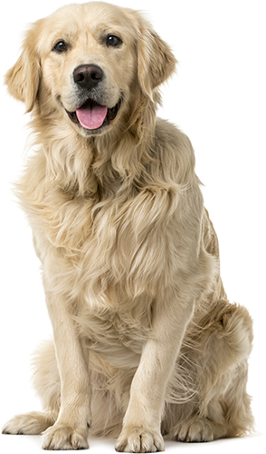
Class Stratification
„All animals are equal,
but some animals are more equal than others.“
Departure of Mr Jones= power vacuum,
Democratic at the begining,
Napoleon= Totalitarianism,
Pigs deemed as superior

Slide 4
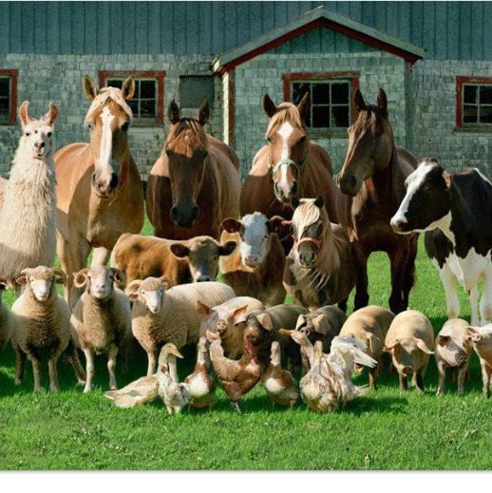
Animal sybolism
The pigs: wisdom, greed, gluttony,
The sheep: meekness, blind followers
The dogs: tools of control, obedience,
The horses: loyalty, diligence
The donkey: stubborness

Slide 5
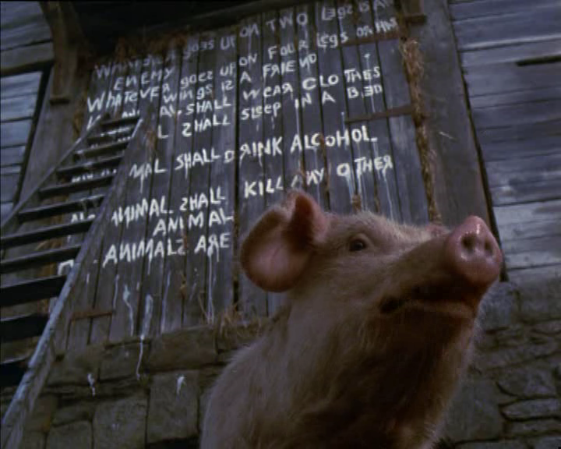
Songs and use of language
„The Beasts of England“
At the begining: unifies the animals,
Used as propaganda throughout the novella,
Twisting the meaning of old Major‘s words

Slide 6
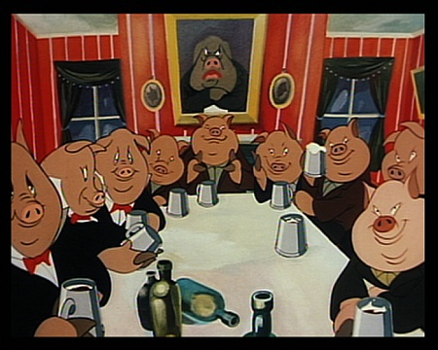
Use and abuse of power
Power vacuum,
Gradual shift from democracy
to totalitarianism,
Pigs: deemed the smartest,
Bending the rules for themselves,
Maintain power through force, empty promises
Naïve and gullible animals,
Snowball: danger to the system
„Napoleon is always right.“

Slide 7
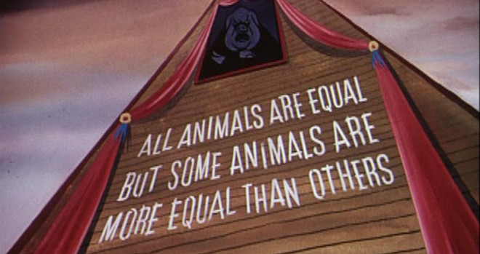
Symbolism: The barn
The collective memory of a modern nation,
The authorities changing a concept from history to their liking,
Control of a nations identity

Slide 8
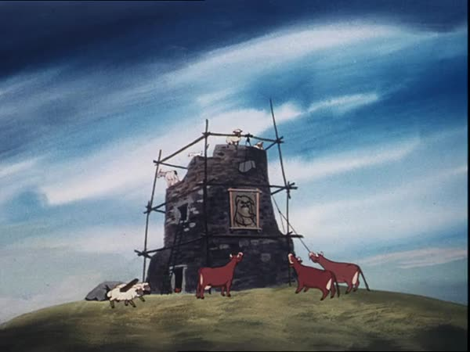
The windmill
False hope for the animals,
Exploitation, psychological manipulation,
Unifies them against a common enemy,
Show of strenght

