Slide 1
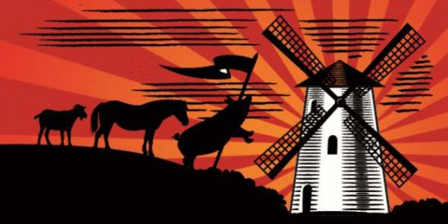
ANIMAL FARM
Student: Maša Štuhec
Professor: Lilijana Kosič

Slide 2
MR. JONES
farmer
first owner of the Manor Farm
unkind master
irresponsible
does not care for the animals

Slide 3
OLD MAJOR
pig
dreamer- sollution: if the animals overthrow Men and take control of the farm, everyone can live in a state of equality
started the rebellion (died soon after)
taught animals song „Beast of England“

Slide 4
NAPOLEON
pig
leader of the Animal Farm after the rebellion
(main villain)
uses millitary force (9 dogs)
controlls all aspects of the farm
tyrant and dictator

Slide 5
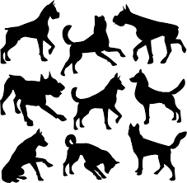
NINE DOGS
brutal, vicious and loyal to Napoleon
pigs bodyguards
intimidating and threating other animals
enforces

Slide 6
SNOWBALL
pig
challenges Napoleon (rival)
inteligent, passionate
wins loyalty of the other animals
moral flaw
„enemy of Animalism“
awarded Animal Hero, First Class after the
Rebellion
idea for the windmill

Slide 7
SQUEALER
pig
squels, a lot
spreads propaganda
twists the truth with rhetorical questions, he could turn black into white
no morals
knows how to play on gut instinct and prejudices
selfish and power hungry

Slide 8

BOXER
cart-horse
strong, loyal,dedicated
quick to help but rather slow-witted
naive, hard working
awarded Animal Hero, First Class after the Rebellion
„I will work harder“
„Napoleon is always right“

Slide 9
CLOVER & MOLLIE
horse
Boxers‘s companion
loyal, gentle and strong
not good with words
horse
vain, materiallistic
quickly leaves the farm

Slide 10
BENJAMIN
donkey
oldest, worst tempered
the wisest animal
pessimistic
skeptical
says: „Life will be hard, no matter who is in charge.“

Slide 11
MR. FREDERICK
owns the neighboring farm of Pinchfield.
tough, shrewd man
little worried that the Rebellion will spread to
other farms (rumors about his animal abuse)
tricks Napoleon
leads the human in the Battle of Windmill

Slide 12
MR. PILKINGTON
owns Foxwood, a neighboring farm
an easy-going gentleman farmer who spent most of his time in fishing or hunting
wealthier and owns more land but
the farm is in need of care

Slide 13
OTHER ANIMALS
Muriel- a wise old goat, can read and is friend with every animal
Moses – the raven, spy and a tale- bearer
sheeps – represent limited understanding of animalism, they blindly support ideas of Napoleon and are manipulated by the Squealer
cows – tricked into revolution, their milk is stolen by the pigs
the cat – does none of the work and is always absent.

Slide 14
QUIZ TIME
https://create.kahoot.it/k/e45771c7-efa2-457c-b547-b6ca1d634af0

